Slide 1

Dr. Sajid Iqbal
Department of Computer Science
Bahauddin Zakariya University, Multan

Slide 2
Computer Programming
Data Types and Operators

Slide 3
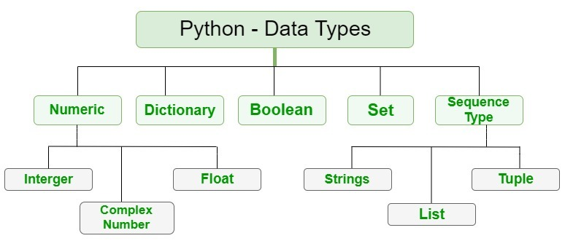
Python Data Types
A data type is a method to represent data in computers
For example a binary number 1011 can be used to represent character ‘a’ or digit 5
A variable can store data of one type at one time
There are number of data types in python
How to get the data type of variable
print(type(c))
Data type | Representation in Python
Text type | str
Numeric types | int, float, complex
Sequence types | list, tuple, range
Mapping Type | dict
Set Types | set, frozenset
Boolean Types | bool
Binary Types | bytes, bytearray, memoryview

Slide 4
Setting the data type automatically
Data Type | Example
str | x = "Hello World"
int | x = 20
float | x = 20.5
complex | x = 1j
list | x = ["apple", "banana", "cherry"]
tuple | x = ("apple", "banana", "cherry")
range | x = range(6)
dict | x = {"name" : “Ali", "age" : 36}
set | x = {"apple", "banana", "cherry"}
frozenset | x = frozenset({"apple", "banana", "cherry"})
bool | x = True
bytes | x = b"Hello"
bytearray | x = bytearray(5)
memoryview | x = memoryview(bytes(5))

Slide 5
Setting data type explicitly
Data Type | Example
str | x = str("Hello World“)
int | x = int(20)
float | x = float(20.5)
complex | x = complex(4+1j)
list | x = list(("apple", "banana", "cherry“))
tuple | x = tuple(("apple", "banana", "cherry"))
range | x = range(6)
dict | x = dict("name" =“Ali", "age" = 36)
set | x = set(("apple", "banana", "cherry“))
frozenset | x = frozenset(("apple", "banana", "cherry“))
bool | x = bool(6)
bytes | x = bytes(5)
bytearray | x = bytearray(10)
memoryview | x = memoryview(bytes(55))

Slide 6
String data type
A string is collection of characters like “I am student”
A string is also called the string literal and can be described as
‘I am student’
“I am student”
Multiline string
You can define the multiline string as follows
“”” I am student at
Bahauddin Zakariya University
Multan, Pakistan”””
Indexing the string
You can extract a single character or multiple characters from string
Name=“I am Sajid Iqbal”
Print(Name[2])
This will print third character of the string that is ‘a’

Slide 7
Python Operators
Operators are used to define operation on operands
+ defines the addition operations on its operands i.e. 5+6
There are numbers of operators that you have used in early mathematics
Python divides the operators in the following groups:
Arithmetic operators
Assignment operators
Comparison operators
Logical operators
Identity operators
Membership operators
Bitwise operators
Arithmetic operators
Operator | Name | Example
+ | Addition | x + y
- | Subtraction | x - y
* | Multiplication | x * y
/ | Division | x / y
% | Modulus | x % y
** | Exponentiation | x ** y
// | Floor division | x // y

Slide 8
Assignment Operators
Operator | Example | Same As
= | x = 5 | x = 5
+= | x += 3 | x = x + 3
-= | x -= 3 | x = x - 3
*= | x *= 3 | x = x * 3
/= | x /= 3 | x = x / 3
%= | x %= 3 | x = x % 3
//= | x //= 3 | x = x // 3
**= | x **= 3 | x = x ** 3
&= | x &= 3 | x = x & 3
|= | x |= 3 | x = x | 3
^= | x ^= 3 | x = x ^ 3
>>= | x >>= 3 | x = x >> 3
<<= | x <<= 3 | x = x << 3

Slide 9
Comparison Operators
Operator | Name | Example
== | Equal | x == y
!= | Not equal | x != y
> | Greater than | x > y
< | Less than | x < y
>= | Greater than or equal to | x >= y
<= | Less than or equal to | x <= y

Slide 10
Logical Operators
Operator | Description | Example
and | Returns True if both statements are true | x < 5 and x < 10
or | Returns True if one of the statements is true | x < 5 or x < 4
not | Reverse the result, returns False if the result is true | not(x < 5 and x < 10)

Slide 11
Identity and Membership Operators
Operator | Description | Example
is | Returns True if both variables are the same object | x is y
is not | Returns True if both variables are not the same object | x is not y
Operator | Description | Example
in | Returns True if a sequence with the specified value is present in the object | x in y
not in | Returns True if a sequence with the specified value is not present in the object | x not in y

Slide 12
Bitwise Operators
Operator | Name | Description
& | AND | Sets each bit to 1 if both bits are 1
| | OR | Sets each bit to 1 if one of two bits is 1
^ | XOR | Sets each bit to 1 if only one of two bits is 1
~ | NOT | Inverts all the bits
<< | Zero fill left shift | Shift left by pushing zeros in from the right and let the leftmost bits fall off
>> | Signed right shift | Shift right by pushing copies of the leftmost bit in from the left, and let the rightmost bits fall off
A | 1 | 0 | 1 | 1
B | 0 | 0 | 1 | 0
A&B | 0 | 0 | 1 | 0
A | 1 | 0 | 1 | 1
B | 0 | 0 | 1 | 0
A|B | 1 | 0 | 1 | 1
A | 1 | 0 | 1 | 1
B | 0 | 0 | 1 | 0
A^B | 1 | 0 | 0 | 1
A | 1 | 0 | 1 | 1
~A | 0 | 1 | 0 | 0
A | 1 | 0 | 1 | 1
A<<1 | 0 | 1 | 1 | 0
A | 1 | 0 | 1 | 1
A>>1 | 0 | 1 | 0 | 1

Slide 13



Thanks for watching
Dr. Sajid Iqbal
Assistant Professor
Department of Computer Science
Bahauddin Zakariya University, Multan
sajidiqbal.pk@gmail.com
https://github.com/sajjo79/Introduction-to-Computers
Allah Hafiz
COMEDXD

